Slide 1

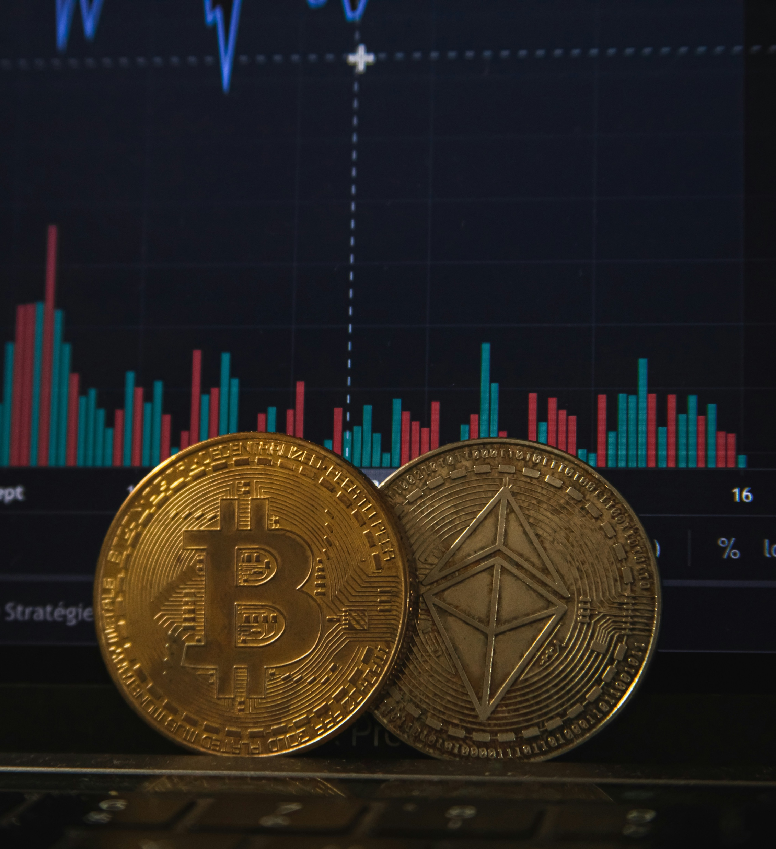
Cryptocurrency Exchange
Landscape in Turkey
By: Peyman Kh
Date: March 12, 2024
Peyman.khodabandehl1@bahcesehir.edu.tr

Slide 2


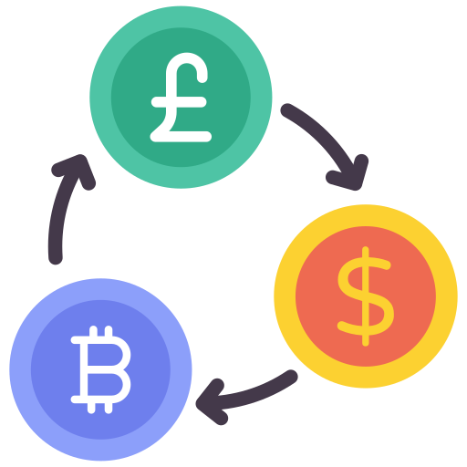

Objectives
In this project, we want to understand the status of leading Turkey cryptocurrency exchanges through data.
What Kinds of Data We Have?
Exchange
Statistics
Volume
Data
Markets
Data
Website
Matrices

Slide 3


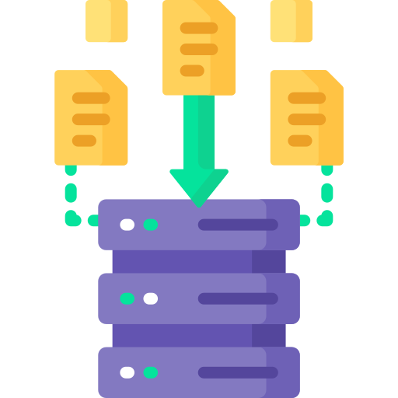
Our Data Source
For this project, the primary data source is bitdegree.org, a platform known for providing information related to cryptocurrencies. The data was extracted from bitdegree.org using web scraping techniques. The scraping process was executed on March 19, 2024, at 11:00.
The scraping process involved navigating the HTML structure of bitdegree.org, locating important information, and extracting relevant data points.
HTML
Website
Finding
Important Data
Extracting
Data Points

Slide 4




Leading Exchanges Overview

Slide 5

Binance TR is a version of the Binance centralized cryptocurrency exchange (CEX) for customers from Turkey. It offers spot market trading, deposits and withdrawals, and direct crypto purchases. The Binance TR cryptocurrency exchange is KYC-compliant. It’s available on desktop and mobile devices.
The Turkish lira is the only fiat currency supported on the platform. All Binance TR crypto prices are listed in TRY.
The Binance TR spot trading supports three key markets:
Crypto-Turkish lira (TRY)
Crypto-Tether (USDT)
Crypto-USD Coin (USDC)

Slide 6

BtcTurk Pro is a centralized exchange that has been operating since 2013 and has its headquarters in Istanbul, Turkey. It claims that it is the first exchange of its type in Turkey as well as the fourth Bitcoin and altcoin trading platform in the whole globe. BtcTurk Pro crypto exchange claims that it has more than 4 million registered customers and is integrated with seven Turkish banks, which enables it to process deposits and withdrawals in Turkish Lira. This service is offered round the clock, seven days a week.
BtcTurk Pro cryptocurrency exchange facilitates both crypto-crypto and crypto-fiat trading with fiat currency being Lira (TRY) only. BtcTurk crypto exchange does not charge a commission for the process of depositing funds. However, there are commissions associated with the withdrawal of certain assets.

Slide 7

Paribu cryptocurrency exchange is a centralized cryptocurrency exchange (CEX) based in Istanbul, Turkey. It offers 24 hours a day 7 days a week services of fast buying, selling, depositing, and withdrawing, as well as infrastructure suitable for high-volume transactions.
Because Paribu crypto exchange is a CEX, a potential user needs to perform a KYC identification positively. Name, surname, and identity number are required. Personal information needs to be provided completely and correctly, and all information should be written precisely as on the identity document. The user’s personal information is kept encrypted and will never be shared with third parties, and it cannot be used for any purpose other than to approve your account.

Slide 8
Statistics

Slide 9
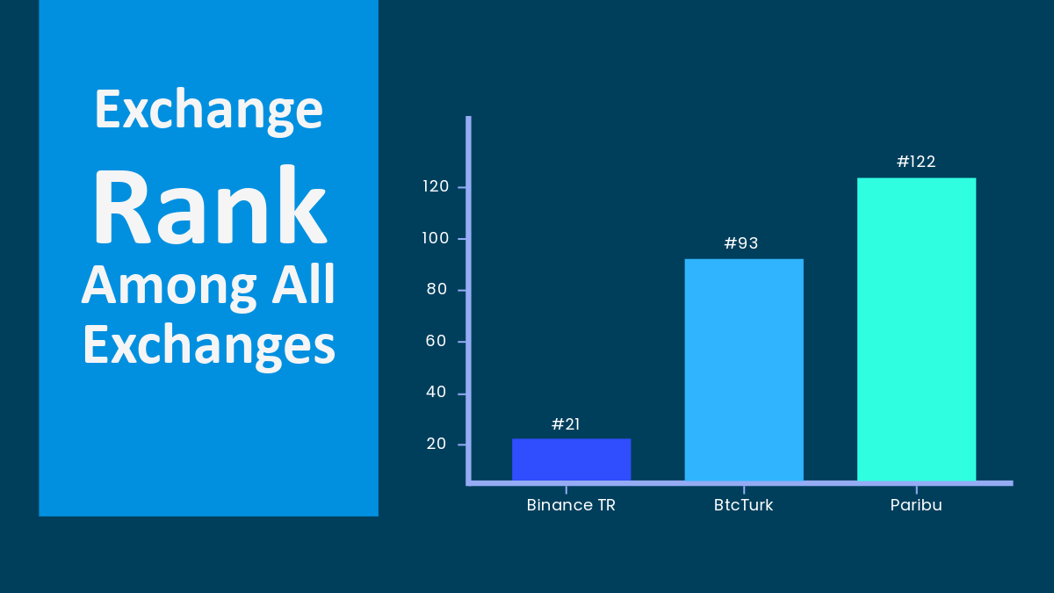

Slide 10
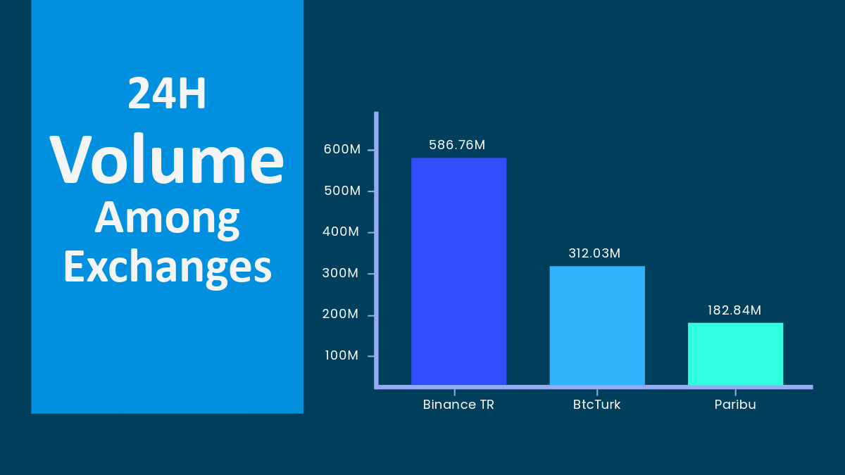

Slide 11
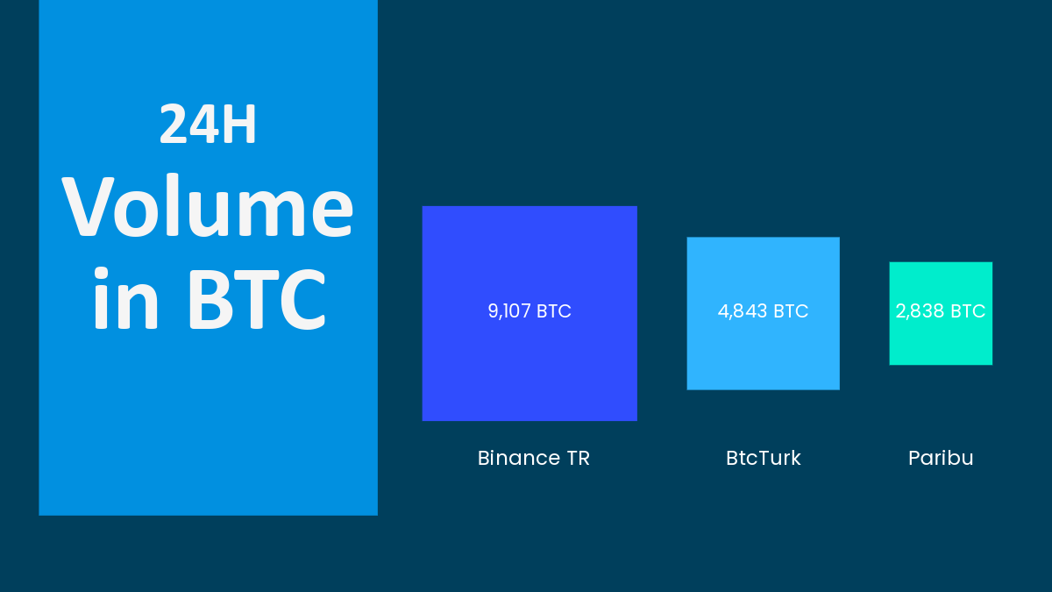

Slide 12
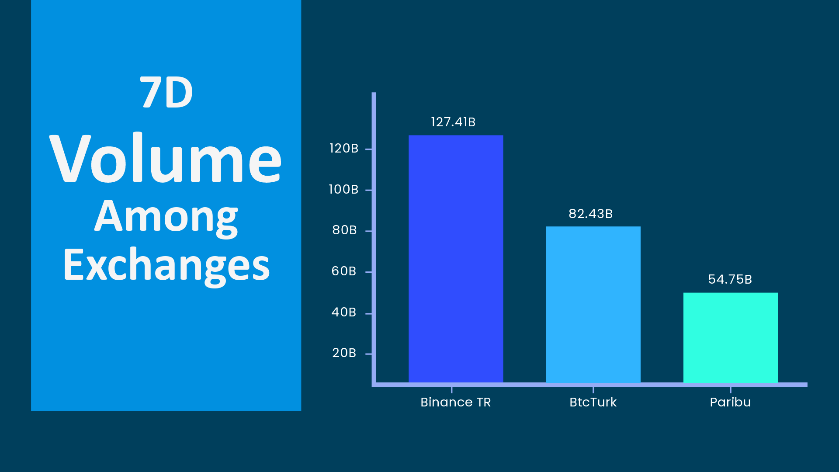

Slide 13
Markets Analysis

Slide 14
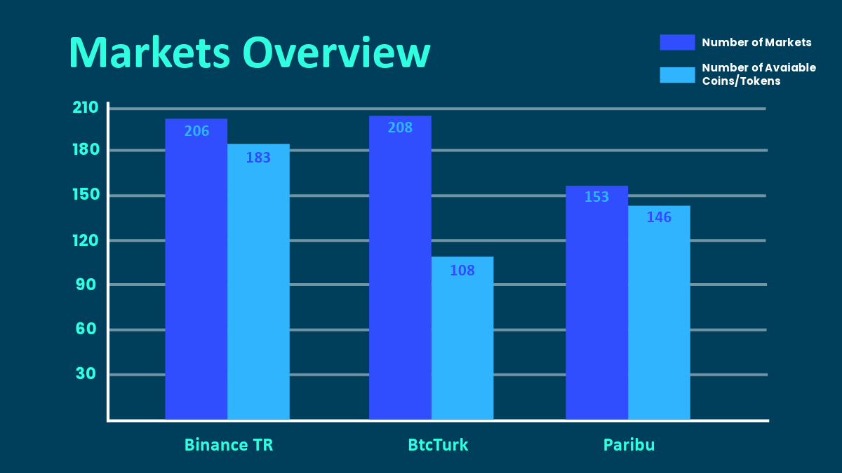

Slide 15
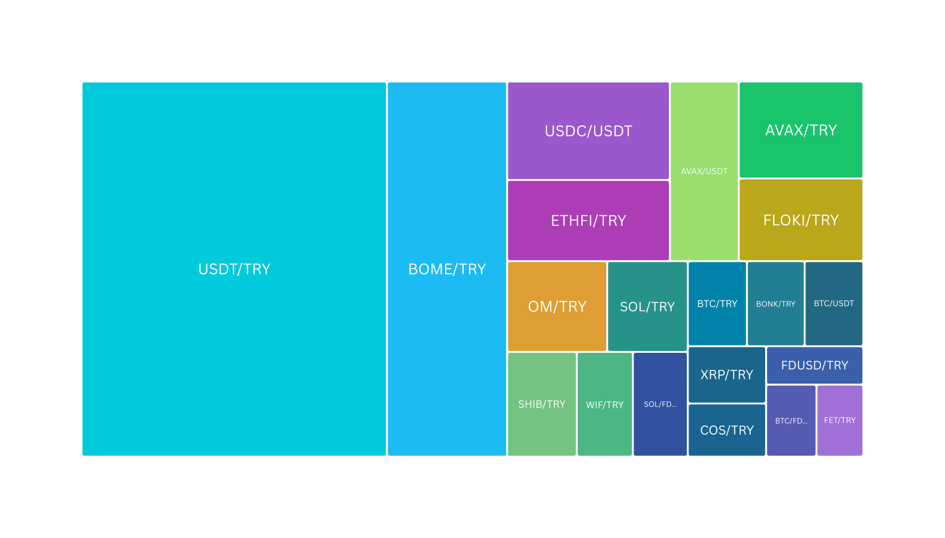
Binance TR Volume Dominance of Top 20 Markets (24H)

Slide 16
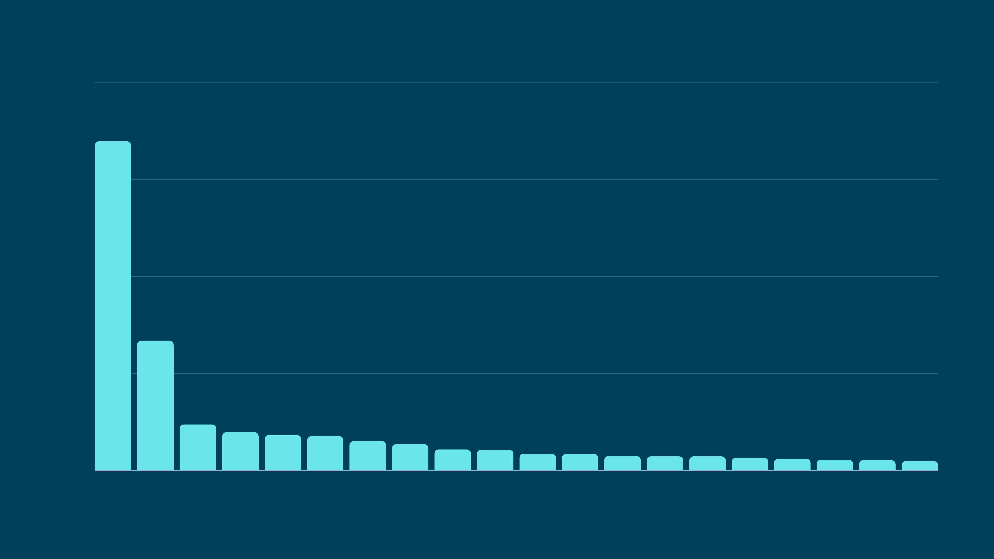
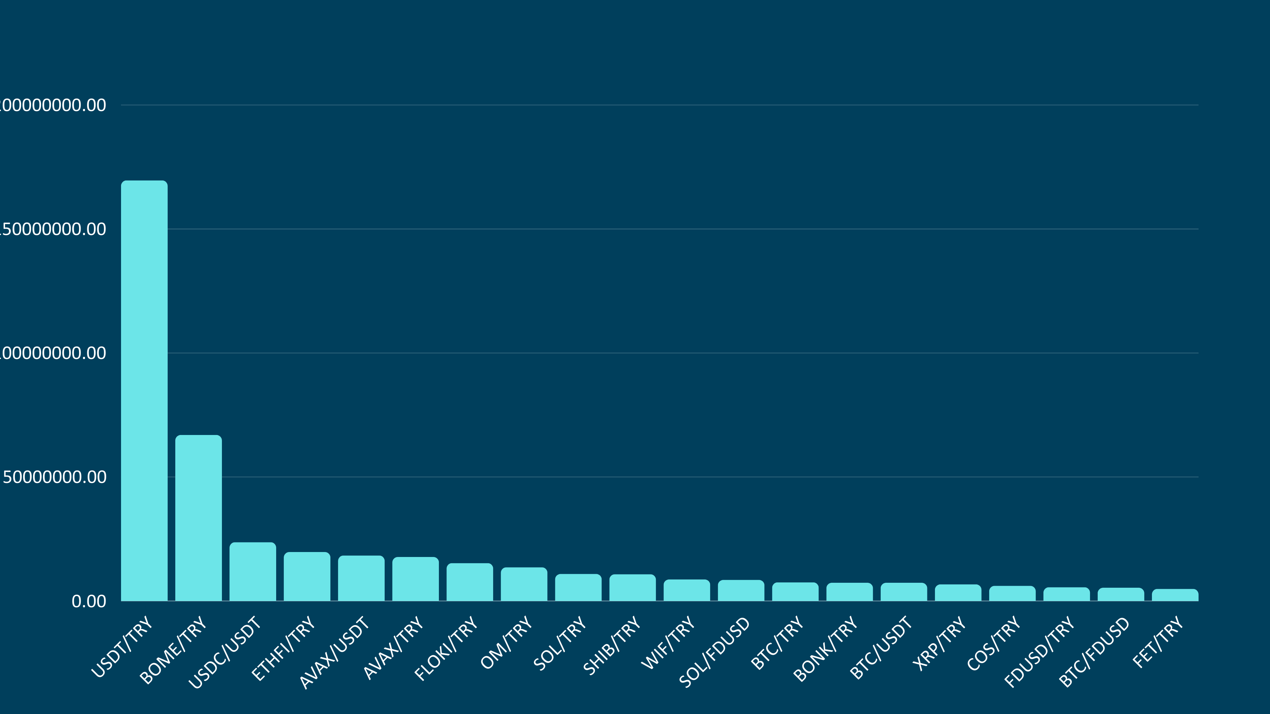
Binance TR Volume of Top 20 Markets (24H)
150M
100M
50M

Slide 17
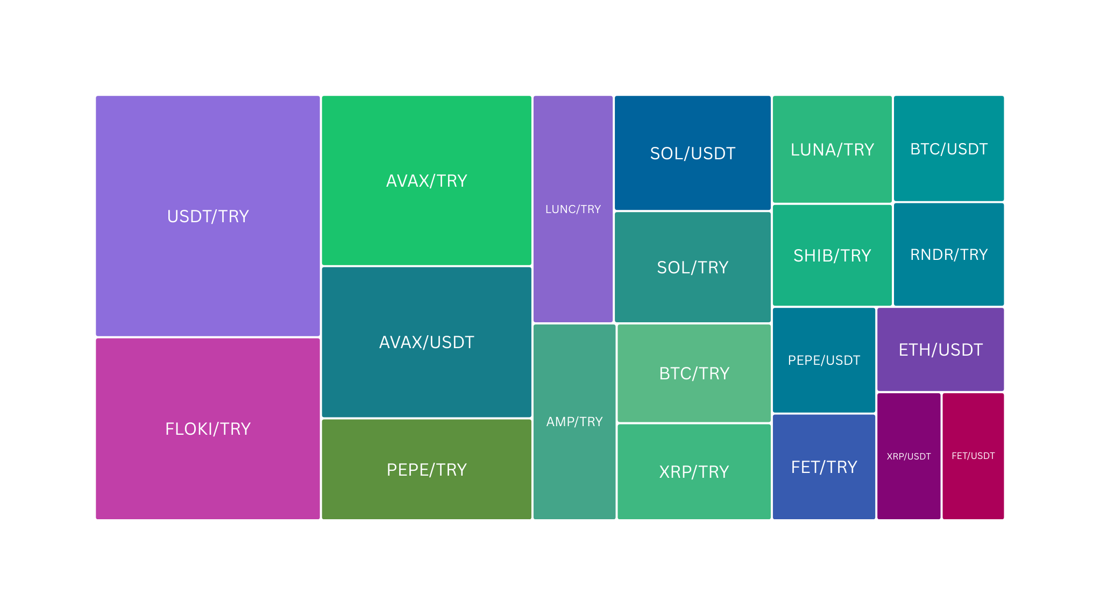
BtcTurk Volume Dominance of Top 20 Markets (24H)

Slide 18
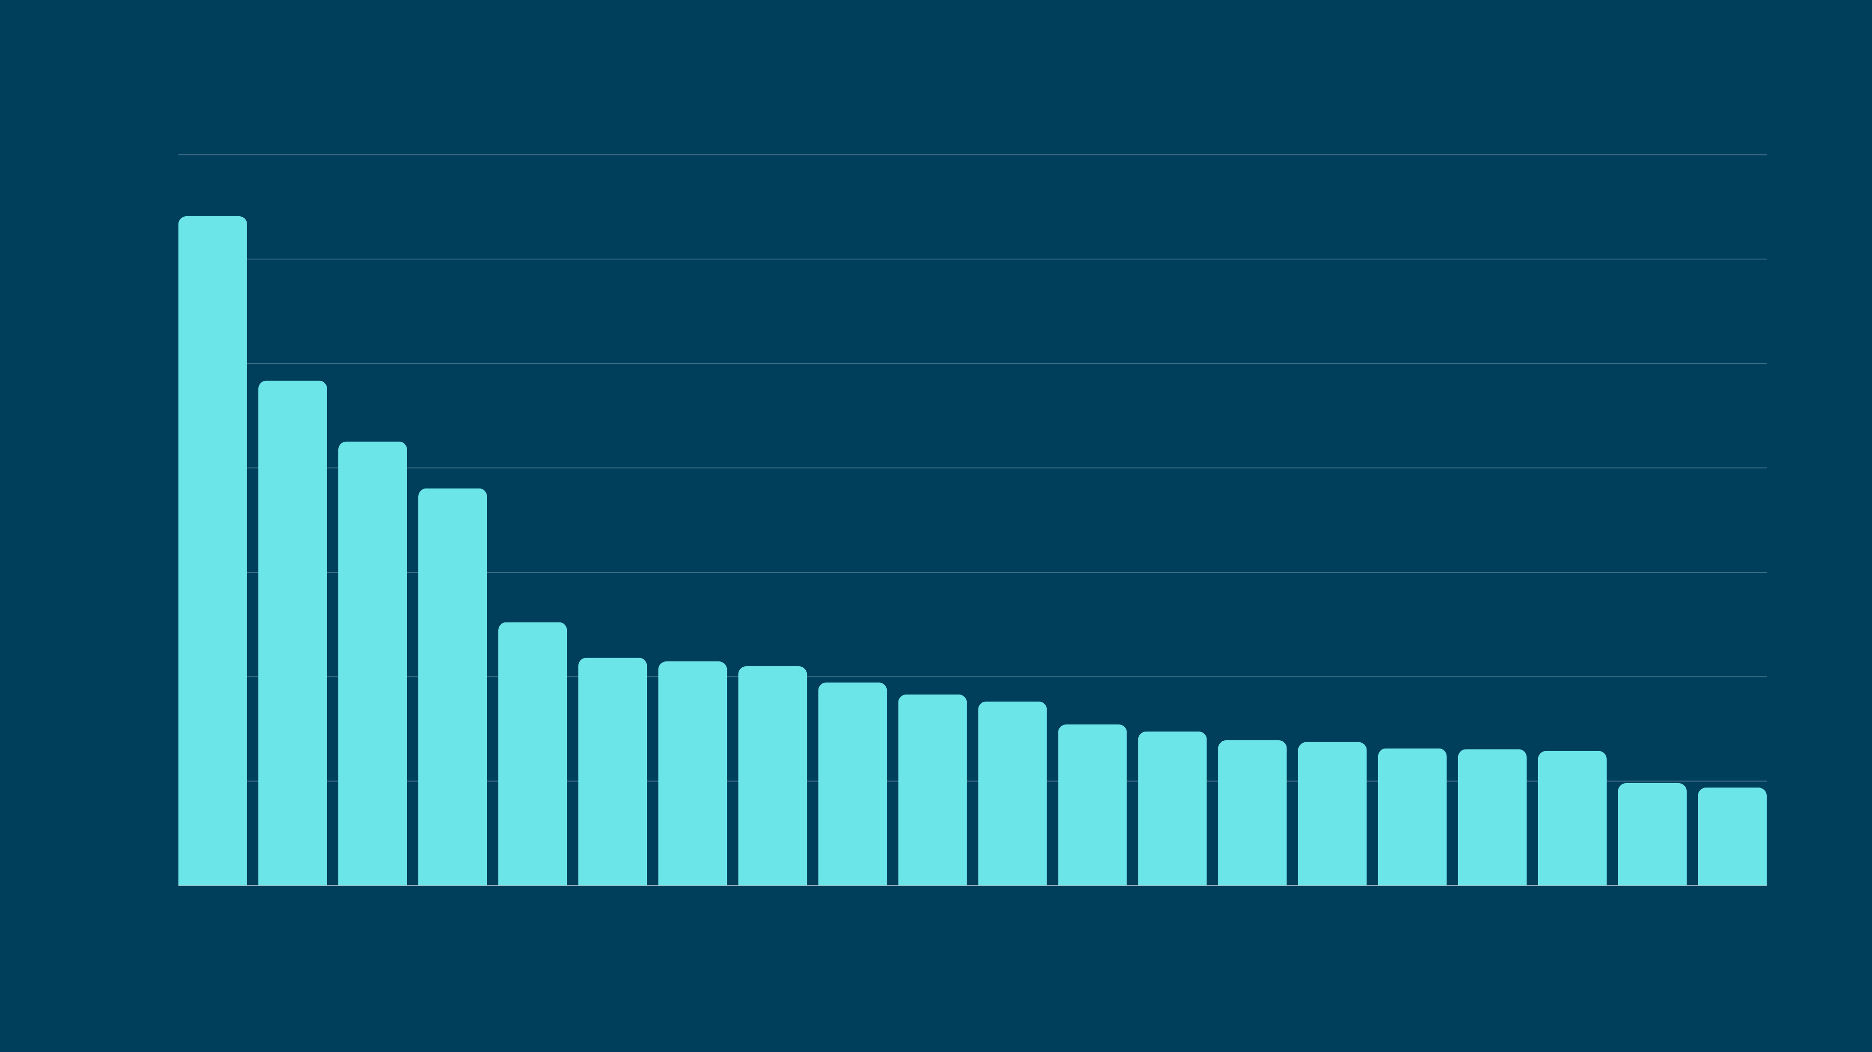
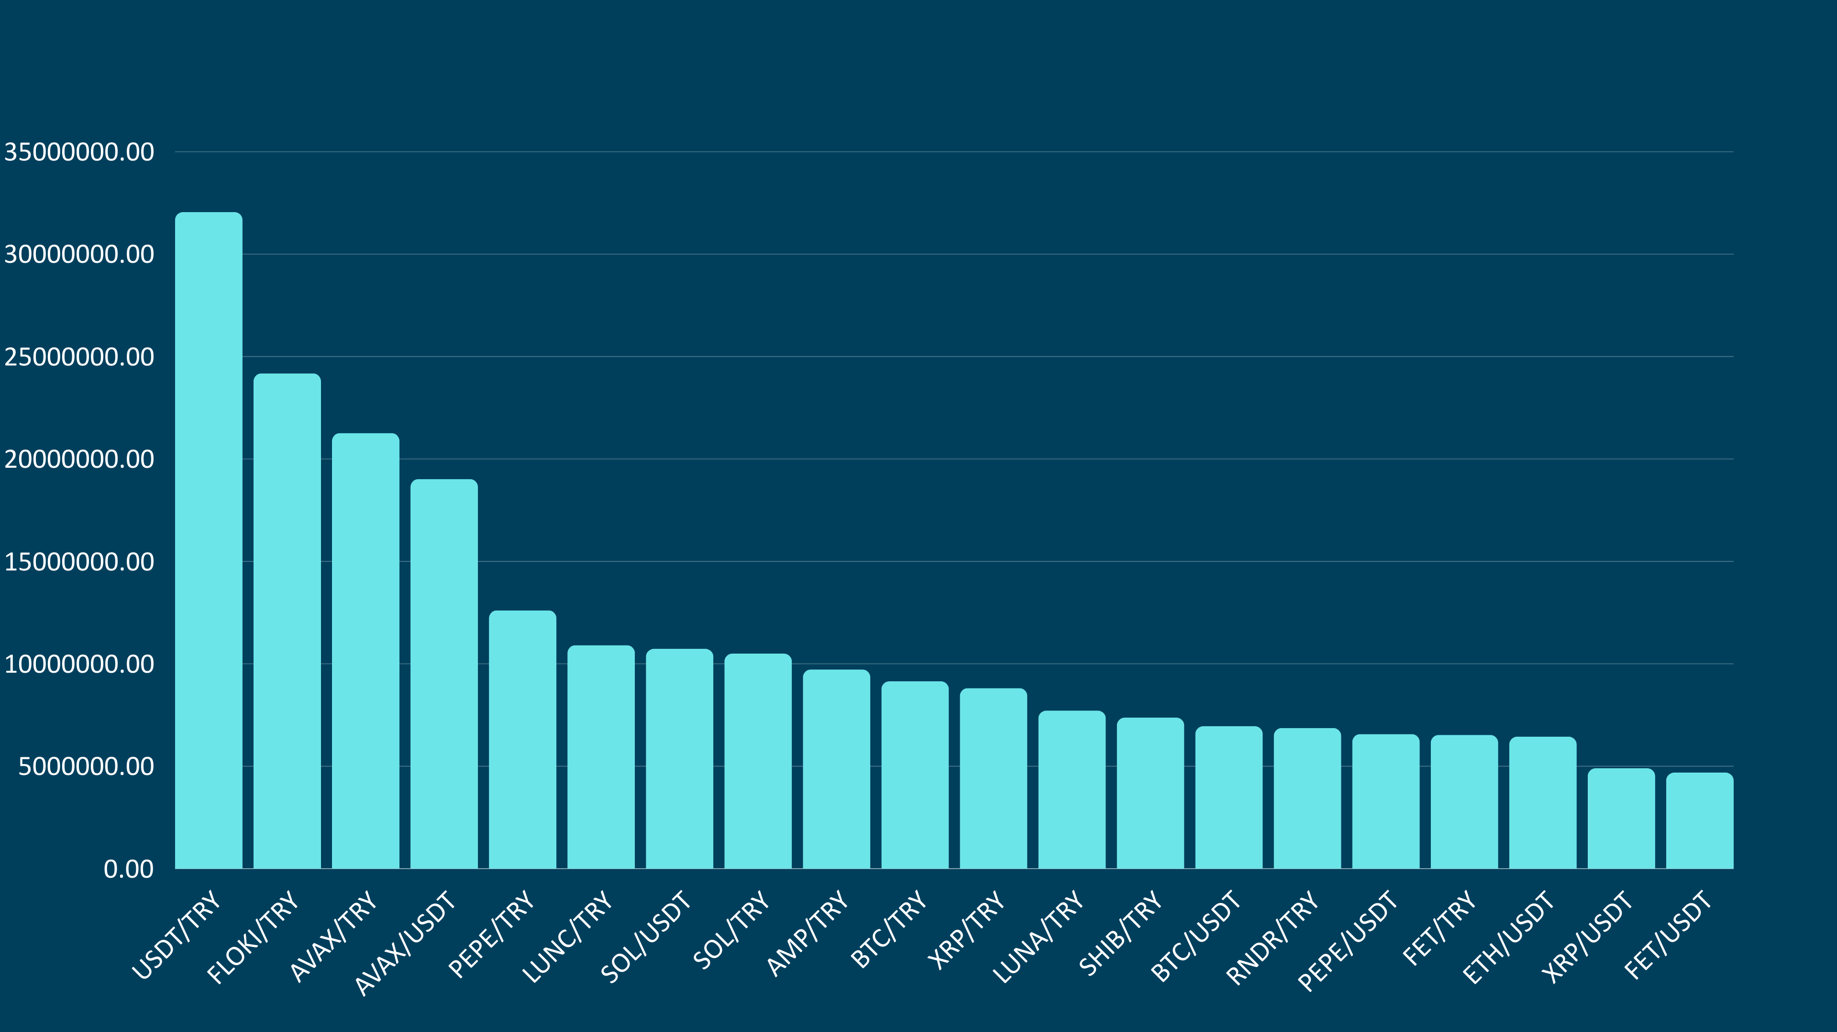
BtcTurk Volume of Top 20 Markets (24H)
30M
25M
20M
15M
10M
5M

Slide 19
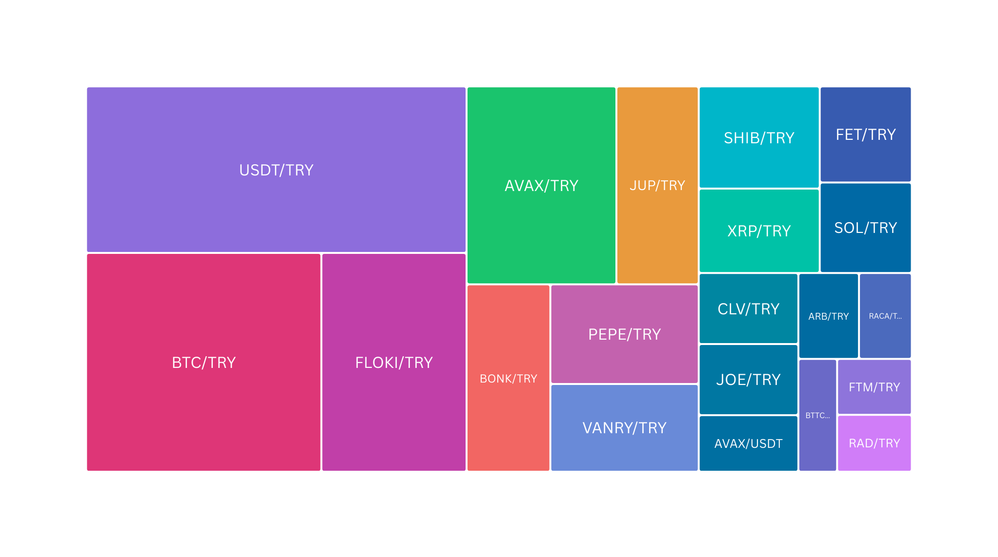
Paribu Volume Dominance of Top 20 Markets (24H)

Slide 20
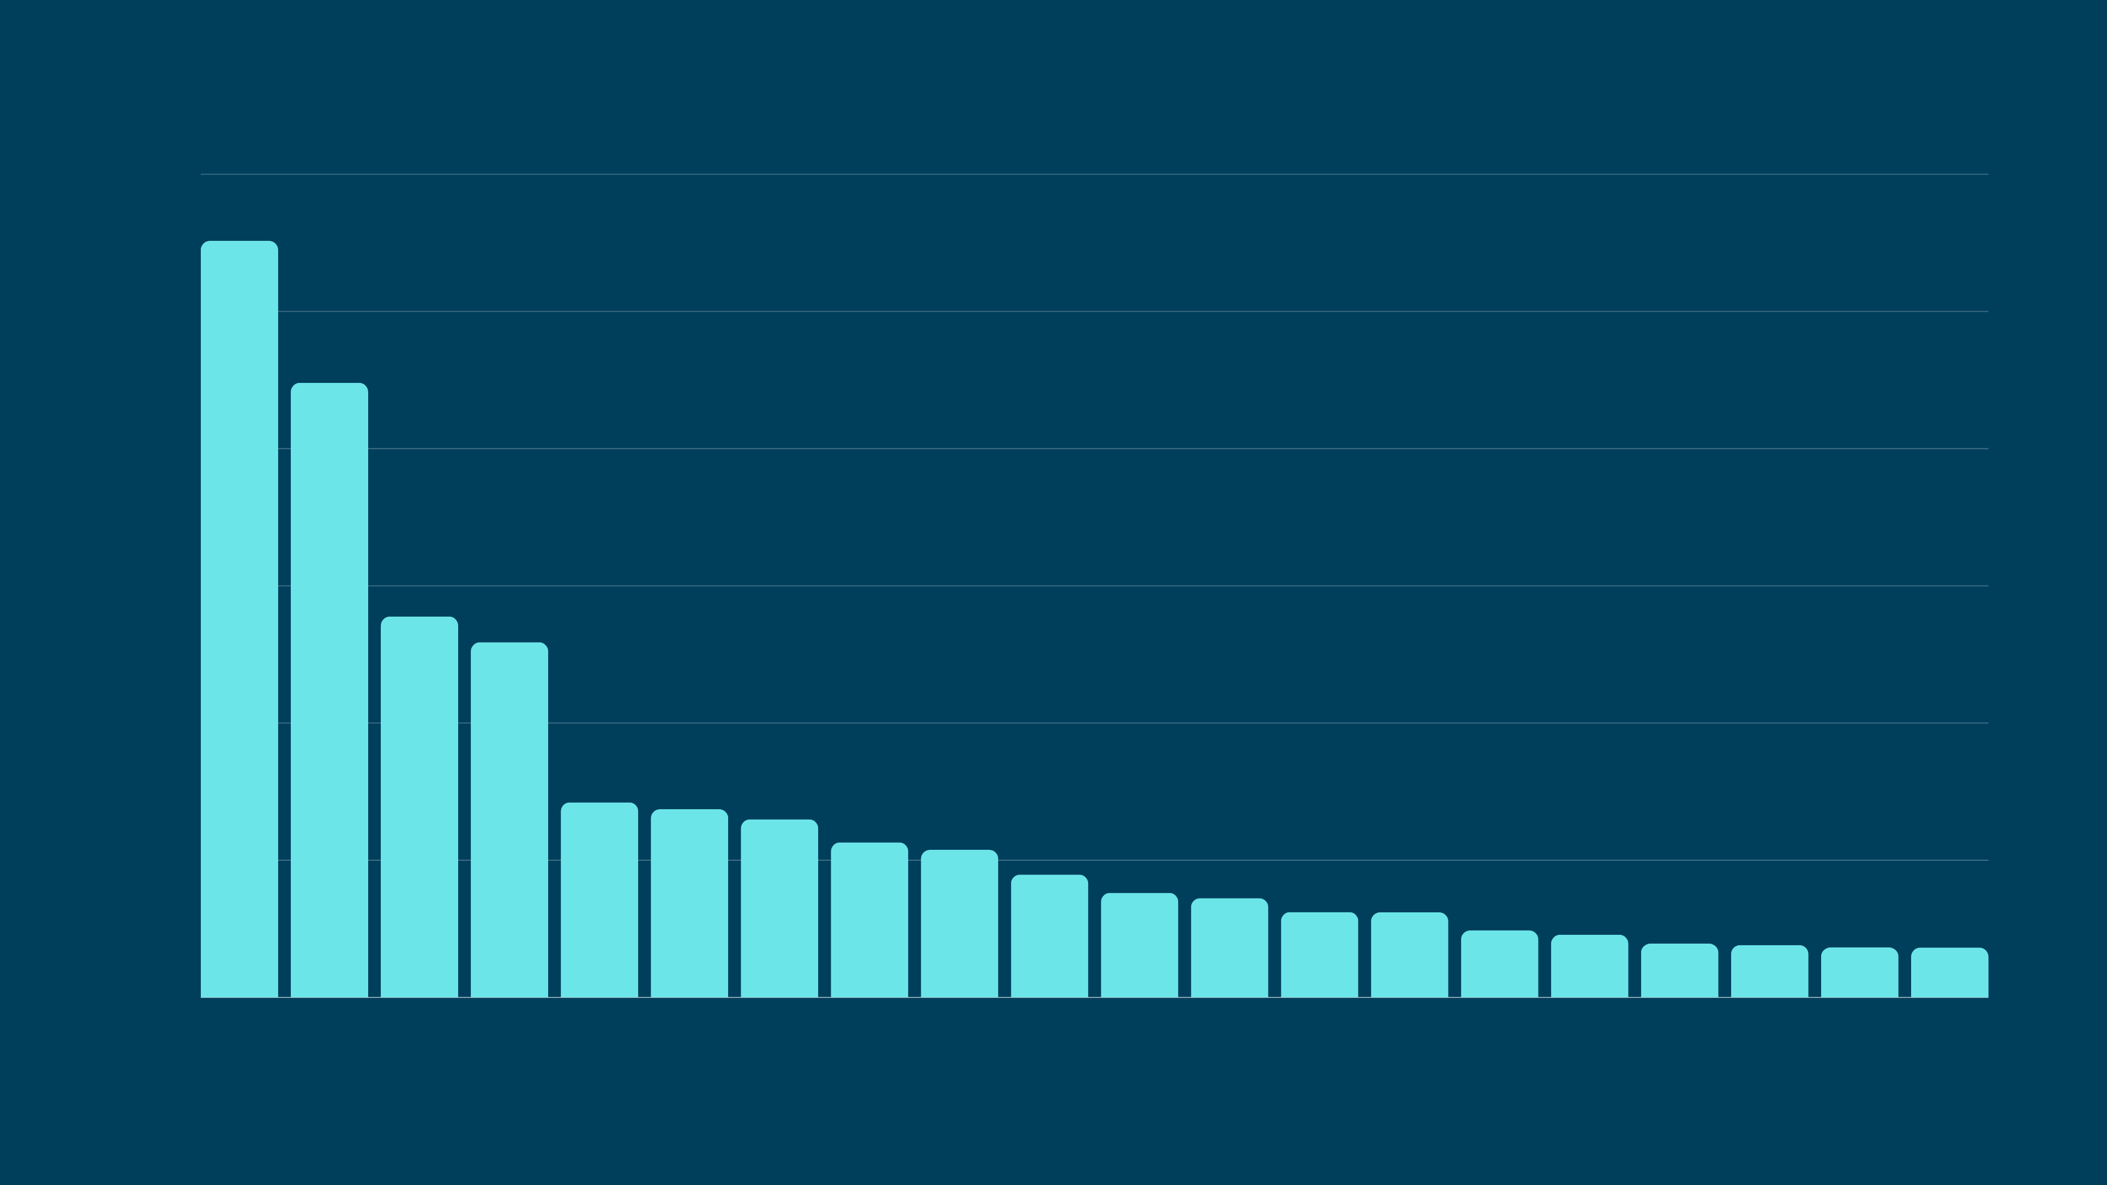
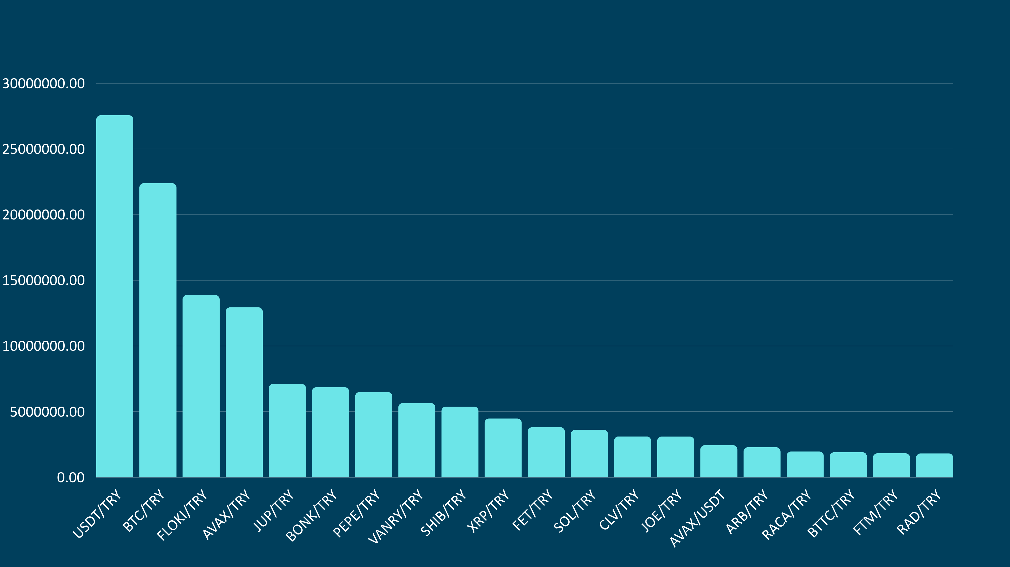
Paribu Volume of Top 20 Markets (24H)
25M
20M
15M
10M
5M

Slide 21


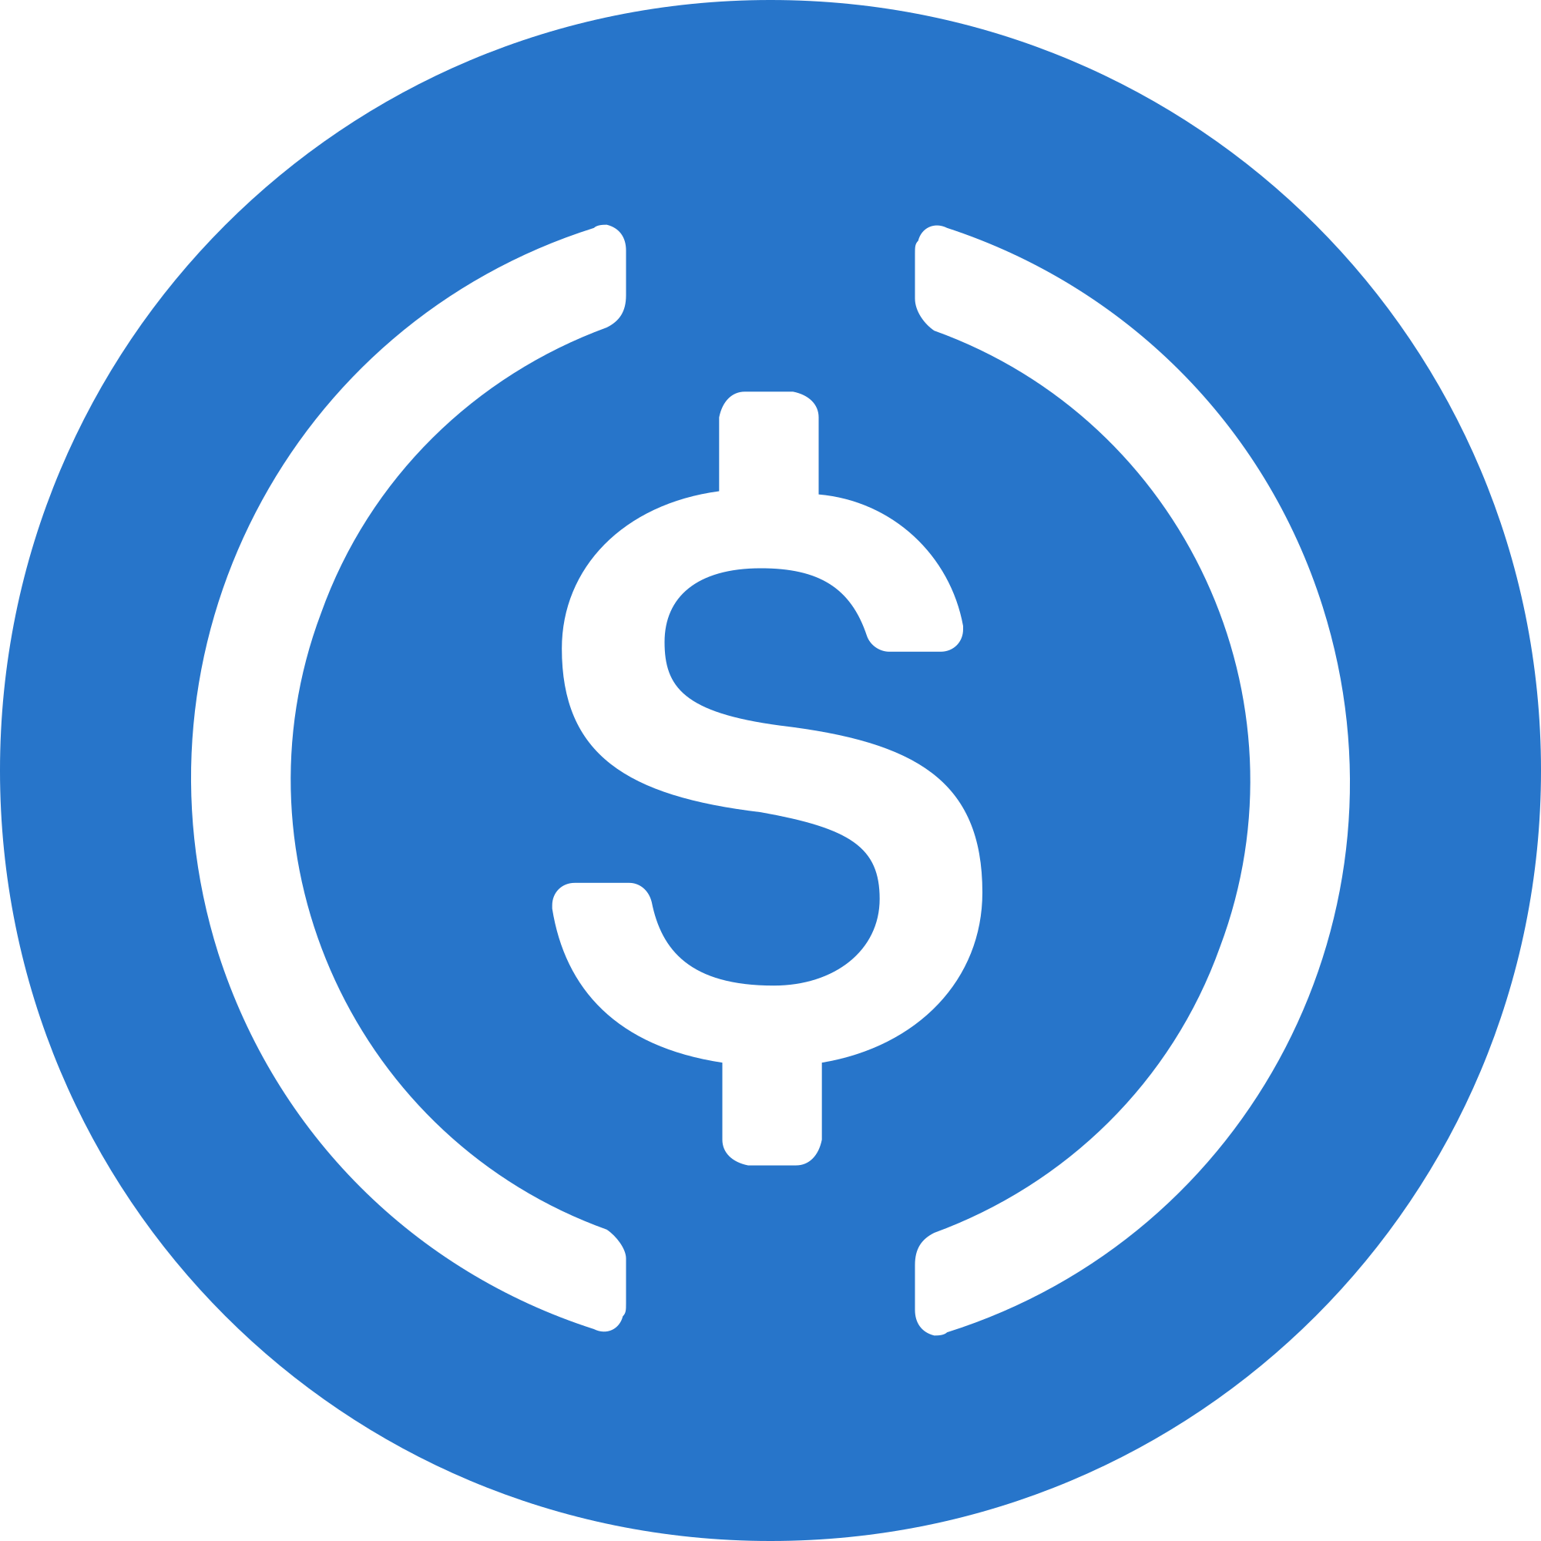
Top Markets in Turkey (24H)
1. USDT/TRY
2. BOME/TRY
3. USDC/USDT
$66,938,384
$229,208,115
$23,701,051

Slide 22
Website Matrices

Slide 23
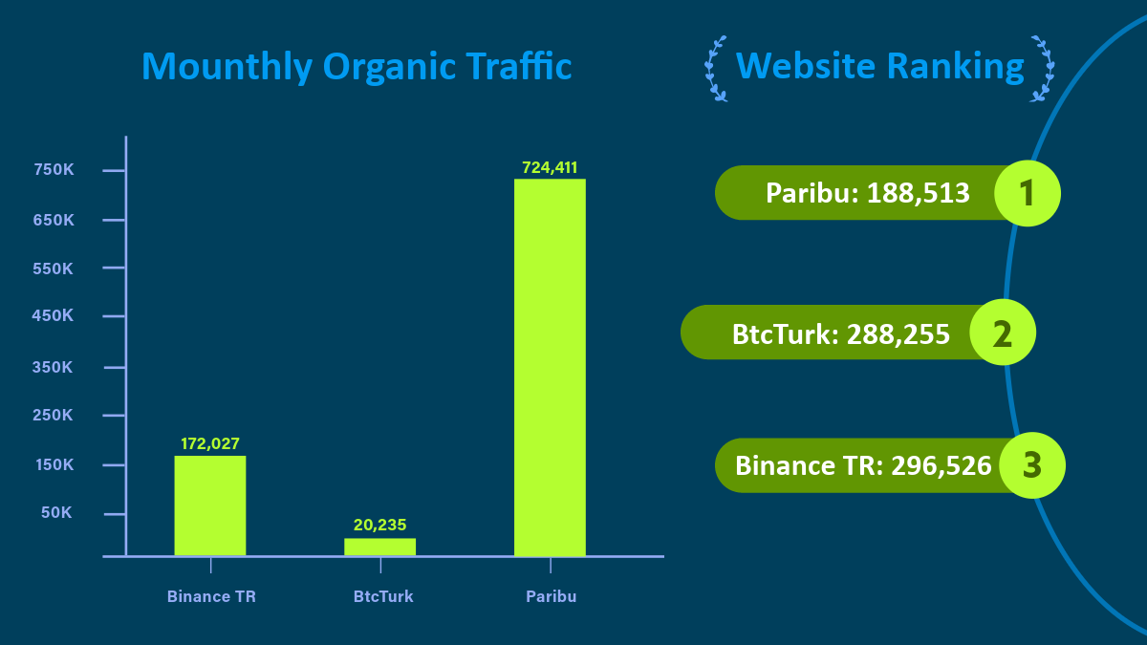

Slide 24


